Slide 1
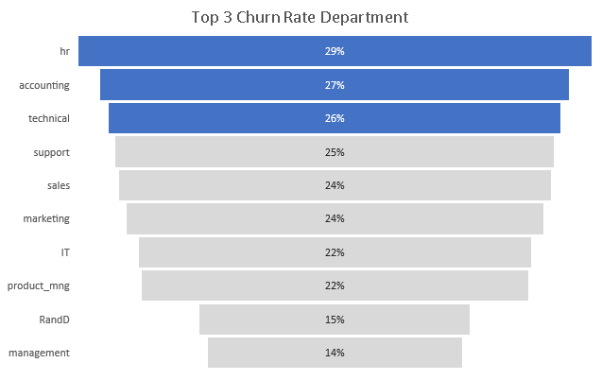
DEPARTMENT
TURNOVER These Departments have the most churn. However, we need to
ask what is the representation of these
departments in the company and what is
driving this churn ?
24% Company Turnover

Slide 2
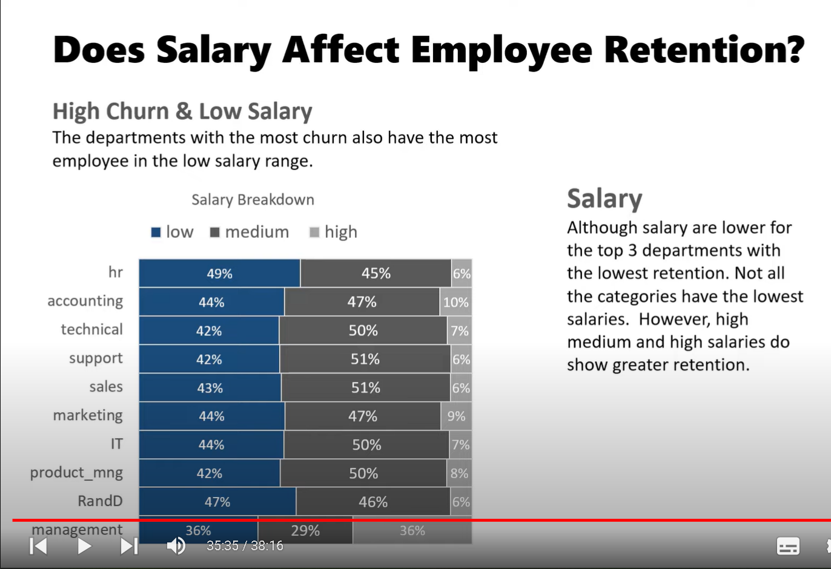
Salary Although salary are low for the top 3 departments with the lowest retention. Not all the categories have the lowest salaries. However, high medium and high salaries do show greater retention.

Slide 3
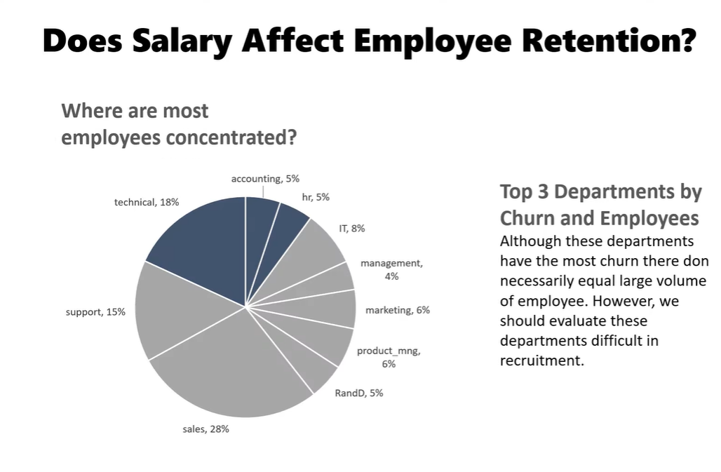

Slide 4
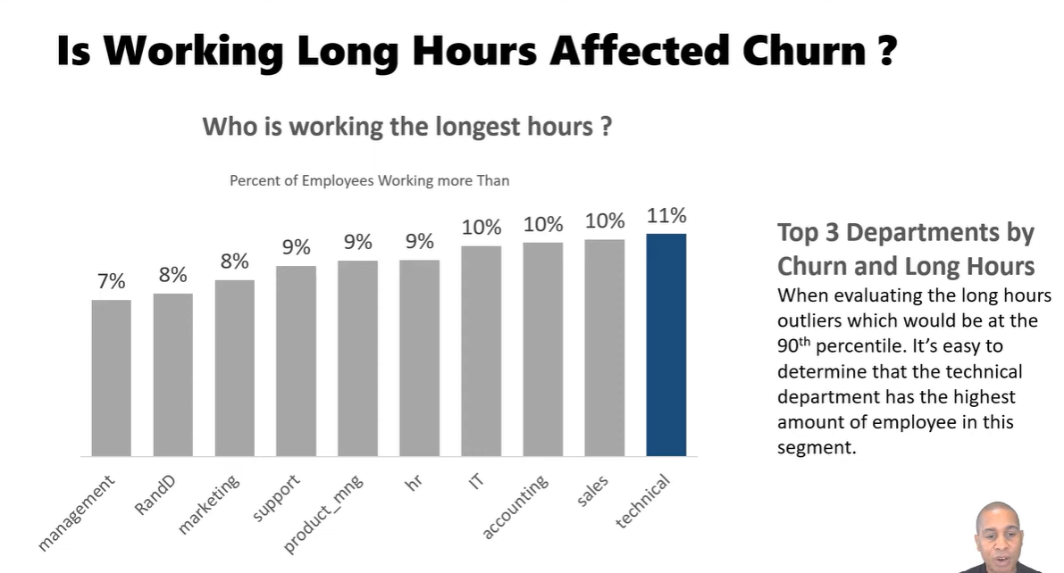

Slide 5
